Slide 1
Some Applications of Superconductors
From the Short Course Tutorial
Superconducting Electronics
2024 Applied Superconductivity Conference
Salt Lake City, Utah USA
1 September, 2024
Steven M. Anlage
Quantum Materials Center
Physics Department
University of Maryland
College Park, MD 20742-4111 USA
anlage@umd.edu
https://anlage.umd.edu

Slide 2
III. Applications of RF Superconductivity
Resonators (Coplanar Waveguide for QC, high-Q for SRF accelerators)
Microwave Kinetic Inductance Detectors
Microwave filters
Josephson-based parametric amplifiers

Slide 3
Resonators
CPW for quantum computing
high-Q for SRF accelerators

Slide 4
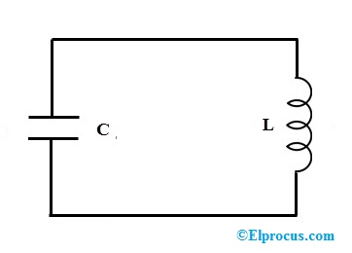
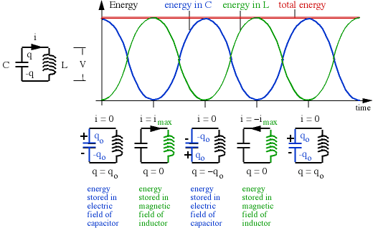
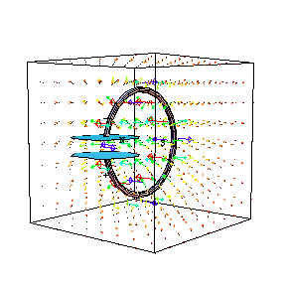

The Inductor-Capacitor Circuit Resonator
resonant
frequency
$$ω_{0}=\frac{1}{\sqrt{LC}}$$
Idealized Lossless Resonator
http://www.phys.unsw.edu.au

Slide 5
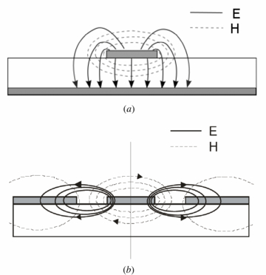
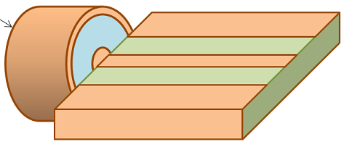
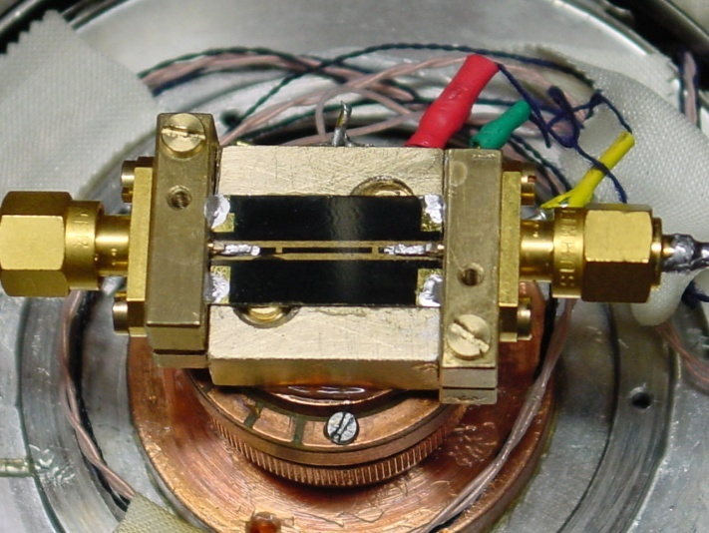
Resonators
CPW Field Structure
… the building block of superconducting applications …
Cavity Quantum Electrodynamics of Qubits
Superconducting RF Accelerators
Microwave kinetic inductance detectors
Metamaterials (μ_{eff} < 0 ‘atoms’)
etc.
ground plane
coaxial
cable
center conductor
coplanar waveguide
co-planar waveguide (CPW)
resonator
P_{out}
P_{in}
Port 2
Port 1
|S₂₁(f)|²
resonator
transmission
Transmitted
Power
driving
frequency
Co-planar waveguide resonator made from YBa₂Cu₃O₇
f₀
[Transmission line resonators]
[CPW RF Currents]

Slide 6
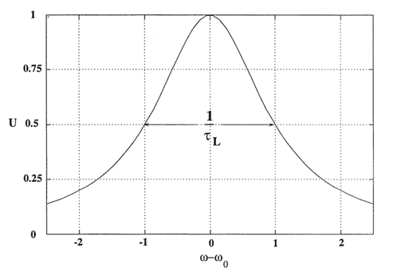





Quality Factor
Two important quantities characterise a resonator:
The resonance frequency $f0$ and the quality factor $Q$
$$Q=\frac{f_{0}}{Δf}=\frac{ω_{0}U}{P_{c}}$$
Stored Energy U
= Δf
$f0$−Δf
$$f0$$
$f0$+Δf
[Q of a shunt-coupled resonator Detail]
Frequency
Where U is the energy stored in the cavity volume and P_{c}/ω₀ is the energy lost per RF period by the induced surface currents
Some typical Q-values: SRF accelerator cavity Q ~ 10¹¹ 3D qubit cavity Q ~ 10⁸

Slide 7
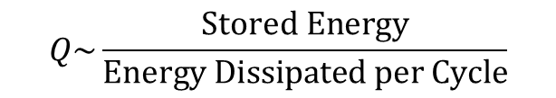
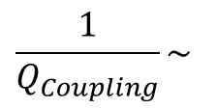
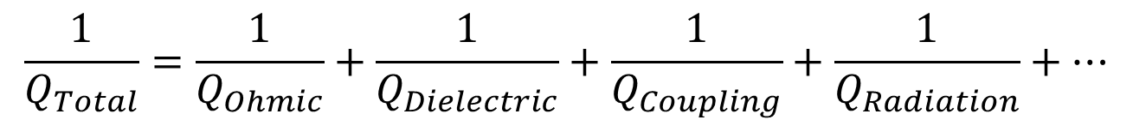
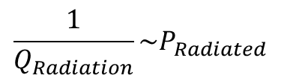
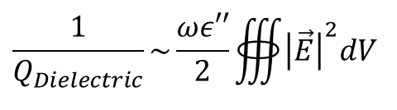
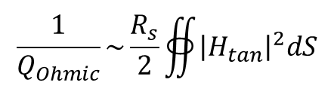
What Determines the Q of Resonators?
$$Q\sim \frac{\text{Stored} \text{Energy}}{\text{Energy} \text{Dissipated} \text{per} \text{Cycle}}$$
Assumption: Loss mechanisms are independent and add linearly
$$\frac{1}{Q_{Total}}=\frac{1}{Q_{Ohmic}}+\frac{1}{Q_{Dielectric}}+\frac{1}{Q_{Coupling}}+\frac{1}{Q_{Radiation}}+…$$
$$\frac{1}{Q_{Ohmic}}\sim \frac{R_{s}}{2}∯{{\left|H_{tan}\right|}^{2}dS}$$
$$\frac{1}{Q_{Radiation}}\sim P_{Radiated}$$
$$\frac{1}{Q_{Dielectric}}\sim \frac{ωε′′}{2}∰{{\left|\vec{E}\right|}^{2}dV}$$
$$\frac{1}{Q_{Coupling}}\sim$$
Power dissipated
in load impedance

Slide 8
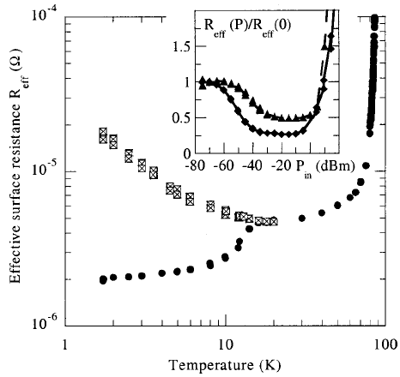

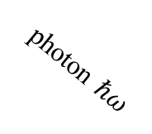

Microwave Losses / 2-Level Systems (TLS) in Dielectrics
TLS in MgO substrates
T = 5K
Classic reference:
-60 dBm
Nb/MgO
YBCO/MgO
The increase in loss as temperature
decreases for -60 dBm is due to the
TLS relaxing back to their ground
state
Effective Loss @ 2.3 GHz (Ω)
-20 dBm
YBCO film on MgO
photon $ℏω$
M. Hein, APL 80, 1007 (2002)
[Power in dBm]
Energy
Low Power
$$Δ≅ℏω$$
Two-Level
System (TLS)
High Power
[TLS Microscopics]
Energy
Notes:
A student at ASC 2024 asked about the increase in loss at low-T in the -60 dBm case.

Slide 9
Resonators
CPW for quantum computing
high-Q for SRF accelerators

Slide 10
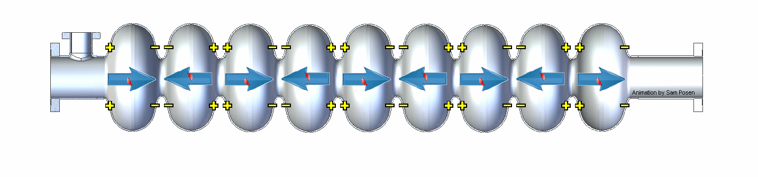
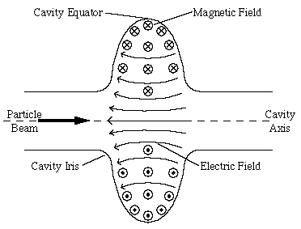
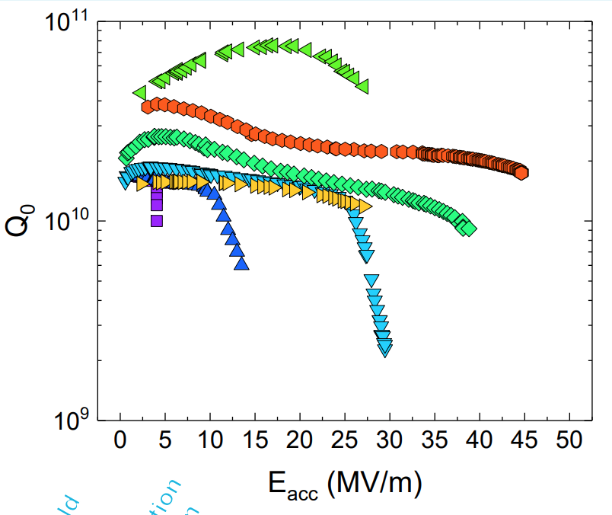


Superconducting Radio Frequency (SRF) Cavity
cross-section of an SRF
microwave cavity (f₀ ~ 1-2 GHz)
$$\vec{E}−Electric Field$$
$$\vec{B}−Magnetic Field$$
$$Charges$$
$$Beam Bunch$$
2017
$$E_{acc}$$
Main material: Niobium (Nb)
T_{c} = 9.2 K, operated at ~ 2 K
Grassalino, SRF2019
https://www.lhc-closer.es

Slide 11
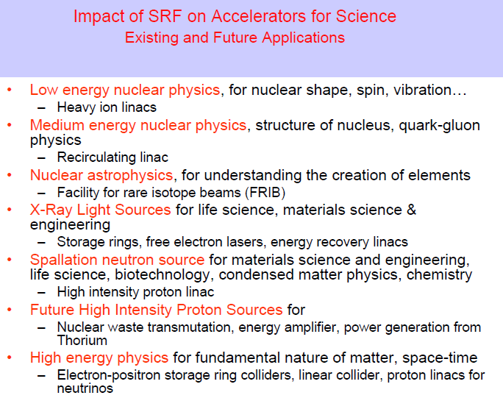
A successful and expanding application of RF superconductivity

Slide 12
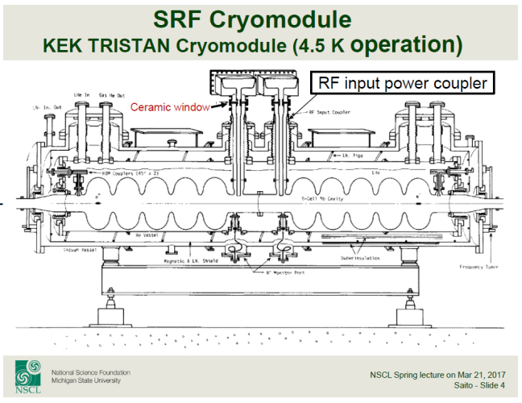
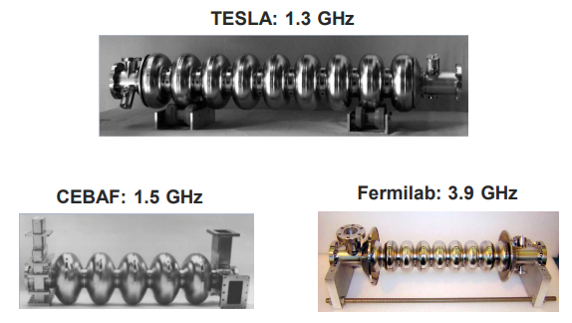
Bulk Nb SRF Cavities and Cryomodules
Very good tutorial on SRF cavities for particle accelerators by Anne-Marie Valente-Feliciano (Jefferson lab): https://indico.jacow.org/event/64/contributions/2903/attachments/314/1203/IPAC23-Tutorial-SRFCav_AMVF.pdf

Slide 13

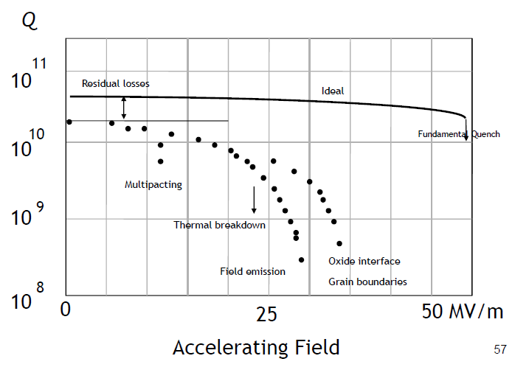
Some research topics:
Reproducibly prepare many high-Q cavities
Maximize Q(E_{acc})
Find higher-T_{c} materials for SRF cavities
Higher Q₀, larger E_{acc}
Materials modifications of Nb to improve E_{acc}
Nitrogen/Oxygen-doping
Replace bulk with thin film Nb on Cu
Prevent / remove trapped magnetic flux in cavities
Understand and eliminate residual microwave loss
E_{acc}

Slide 14
Superconducting Microwave Filters

Slide 15
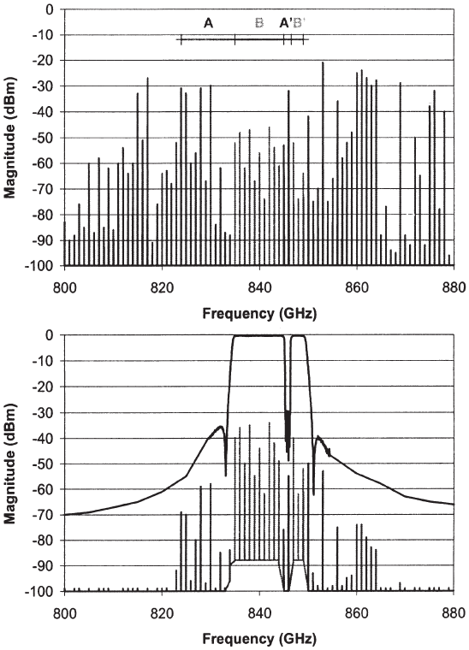
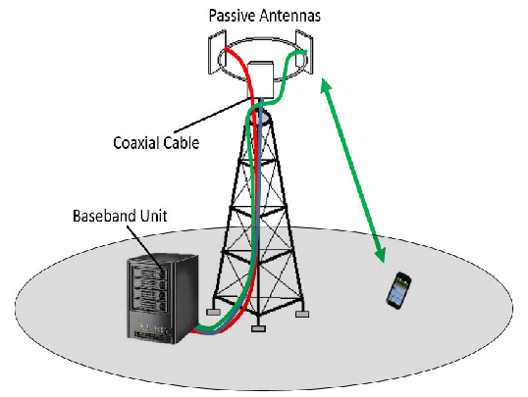
Superconducting Microwave Filter Application
Front-end filter and
low-noise amplifier
Before
Band-pass
filter
notch
After
The electromagnetic spectrum is very crowded
Need to recover weak signals from distant users, and exclude interference
Low-loss band-pass filter to pass only signals inside allocated band
Add low-noise amplifier on cryogenic platform
[Microwave Filter Application]

Slide 16
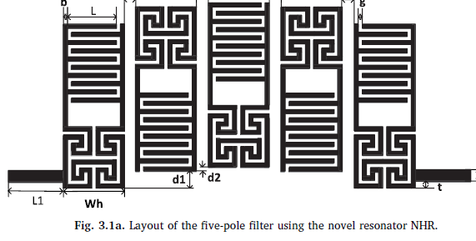
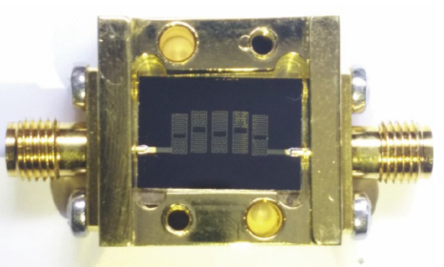
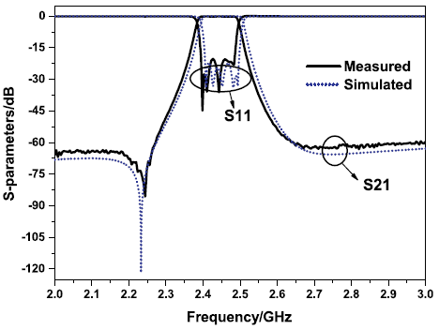
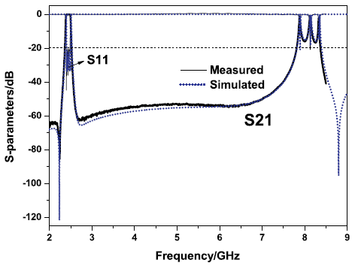
Microwave Filters are a Collection of Coupled Resonators
The resonators are implemented
in thin superconducting films
DyBa₂Cu₃O₇ film
T = 79.4 K
wide upper stopband
Hongwei Yue, et al., Physica C: Superconductivity 557, 1 (2019)

Slide 17

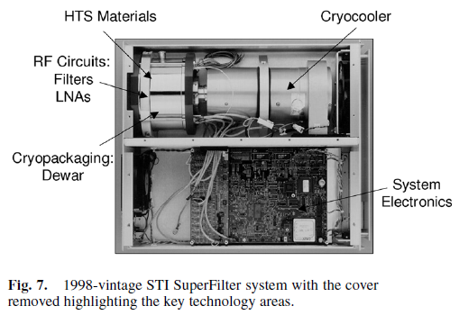
High-T_{c} Superconducting (HTS) Microwave Filters – Description of Application
notch
B. A. Willemsen in H. Weinstock and M. Nisenoff, Microwave Superconductivity. (Springer Netherlands, 2012).

Slide 18
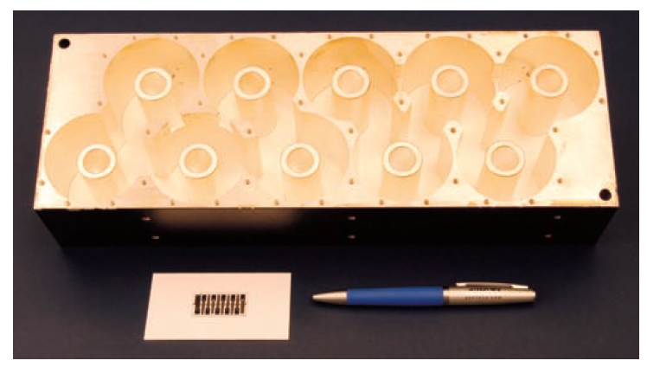
High-T_{c} Superconducting (HTS) Microwave Filters – Long-Term Impact
Microwave filter design
Coupled resonators! Higher Q-factors allows for more aggressive designs. Filter design is a high art
Better performance in filter response requires using more resonators
Typically used to define a band-pass or band-reject filter
Bulk 3D
normal metal
Advantages of HTS Microwave Filters
Small size compared 3D normal metal structures with comparable Q
Low insertion loss in the pass-band
High out-of-band rejection, steep cutoff, narrow-bandwidth and highly selective
Integrate with cryogenic low-noise semiconductor amplifier to improve system SNR
Increased range of reception
At one point (early 2000’s) ~10⁴ HTS filters with cryocoolers in operation in the USA
2D superconducting
HTS microwave filters encouraged the development of:
Low-maintenance stand-alone closed-cycle cryocoolers with long MTBF (~ 5 years between maintenance)
HTS T_{c} ~ 100 K, operated at about 60 K (N.B. most SC applications require T_{operating} ~ T_{c}/2)
Low power, compact, efficient cryocoolers
Two-dimensional (thin film) RF circuits – more compact and easier to cool
Low thermal conductivity microwave cables (connecting R/T-cryogenic)

Slide 19
Microwave Kinetic Inductance Detectors

Slide 20
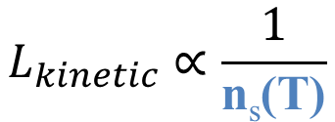

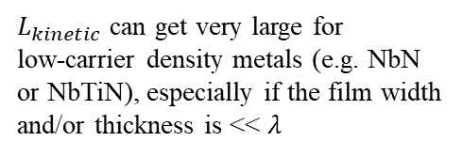
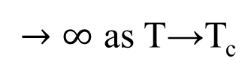
Kinetic Inductance
superconducting
wire
Geometrical
Kinetic
AC Current-carrying superconductor
J_{s}
J = J_{s} + J_{n}
J
J_{n}
n_{s}(T)
n_{n}(T)
J_{s} = (-2e) n_{s} v_{s}
n
n = n_{s}(T) + n_{n}(T)
As T→T_{c}, n_{s} ↓, v_{s}↑, to maintain J_{s}
$$U=\frac{1}{2}L_{kinetic}I^{2}$$
0
T
So the kinetic energy of the Cooper pairs must increase!
T_{c}
$L_{kinetic}$ can get very large for
low-carrier density metals (e.g. NbN
or NbTiN), especially if the film width
and/or thickness is << $λ$
$$L_{kinetic}∝\frac{1}{\text{n}\text{s}\text{(}\text{T}\text{)}}$$
$→∞$ as T→T_{c}

Slide 21
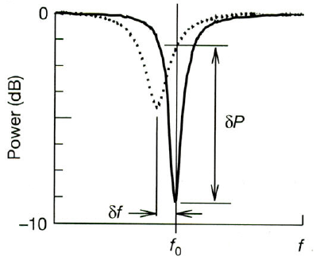
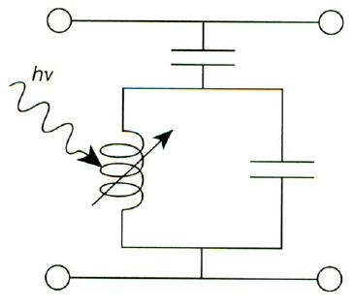
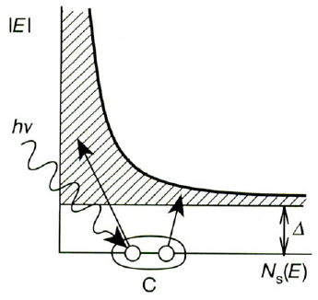
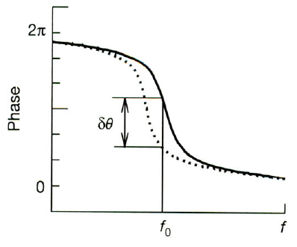


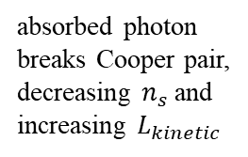


Microwave Kinetic Inductance Detectors (MKIDs)
Integrate a superconducting wire into a compact LC resonator
An absorbed photon breaks a Cooper pair, changes the kinetic inductance of the wire, and shifts the resonance
Monitor the frequency shifts of many resonators (pixels) simultaneously
absorbed photon
breaks Cooper pair,
decreasing $n_{s}$and
increasing $L_{kinetic}$
microwave input
microwave output
$$L$$
$$C$$
$$L_{kinetic}\sim \frac{1}{n_{s}}$$
$$f_{0}=\frac{1}{2π \sqrt{LC}}$$
Sensitive to THz-PHz photons
P. K. Day, et al., Nature 425, 817 (2003)

Slide 22
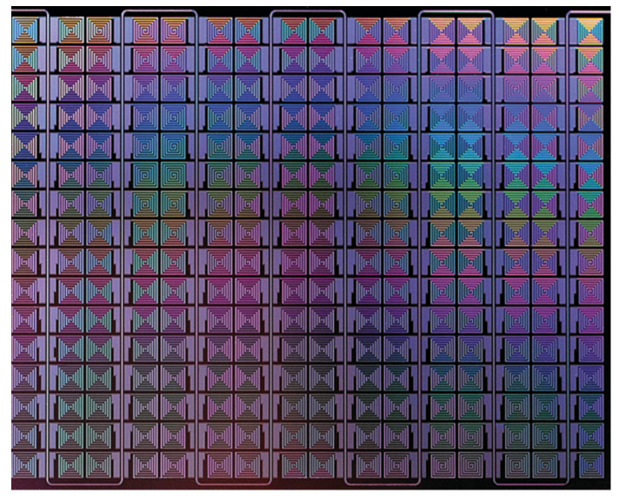
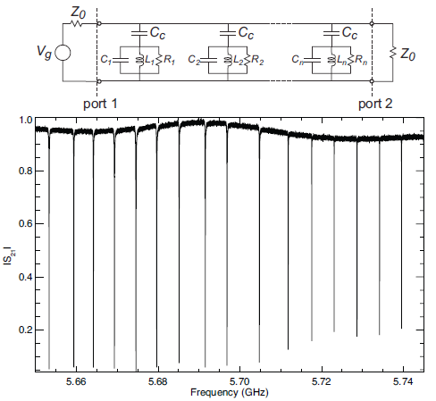
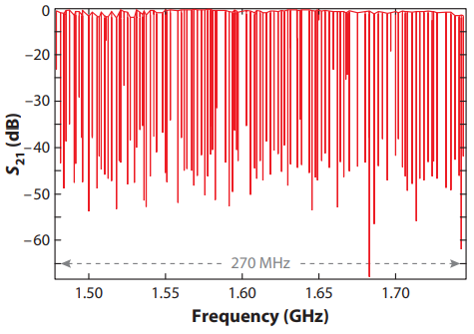

Multiplexing of MKIDs
Each resonator is a different pixel in an array
16x16 array
of lumped LC
resonators
Readout single-photon energies and arrival times
in the imaging array
Transmission $|S_{21}|$
128 pixels
Superconductivity provides high-Q resonances
J. Zmuidzinas, Ann. Rev. of Condensed Matter Physics 3, 169 (2012)
Notes:
16x16 = 256. (a) A 16 16 array of TiN lumped-element microwave kinetic inductance detectors using a spiral inductor and an interdigitated capacitor. The pixels are approximately 0.6 mm in size. (b) The measured resonances for half the array (128 pixels) are very deep and fall into a 270-MHz band centered at 1.6 GHz. (c) The internal quality factors are very high, Qi > 107 , with good uniformity.

Slide 23
Josephson-Based
Parametric Amplifiers

Slide 24
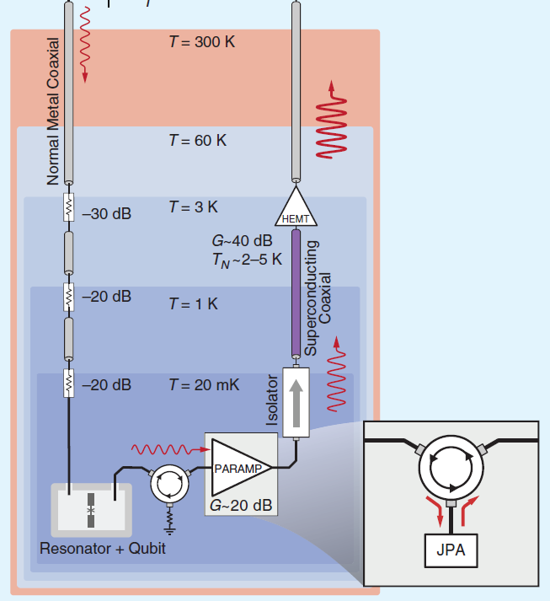
Josephson-Based Parametric Amplifiers
Problem: Recover very small microwave signals from a cryogenic resonator
Amplify the signal (the first of several stages)
Add a minimal amount of noise to the signal
Solution: Use Parametric Amplification to recover the small signal
Dilution
Refrigerator
Need to locate amplifier near qubits on the MXC (20 mK) plate –
small cooling power, hence low dissipation required
Amplifier must also have minimal back-action on the qubits
What is Parametric Amplification?
J. Aumentado, IEEE Microw Mag 21, 45 (2020)

Slide 25
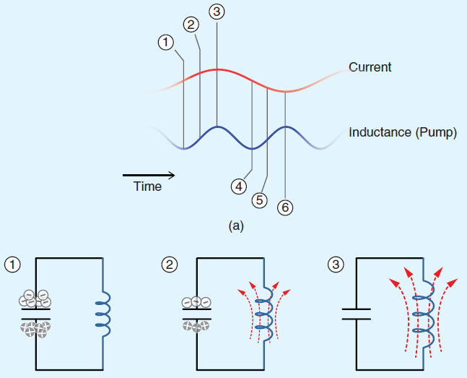
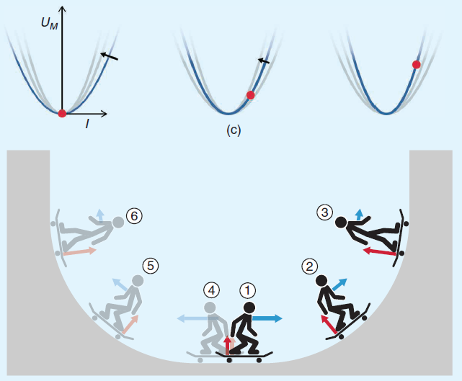






Parametric Amplification – The Basic Idea
Signal to be amplified at frequency $f_{Signal}$
Pump energy into the ideal LC-resonant
circuit by modulating the inductance at
twice the resonant frequency, while
utilizing the correct phase.
(called degenerate parametric amplification)
Parametric pump at frequency $f_{Pump}$
$$L$$
$$L$$
$$L$$
$$U_{M}=\frac{1}{2}L(t)I^{2}$$
J. Aumentado, IEEE Microw Mag 21, 45 (2020)

Slide 26
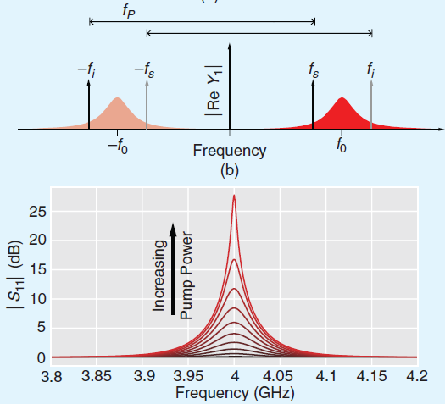
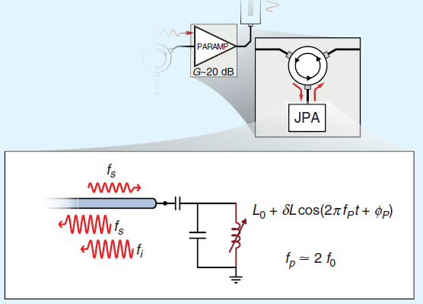





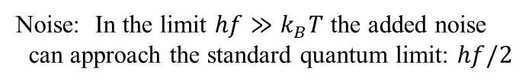







Josephson-Based Parametric Amplification
Gain
$$f_{Signal}$$
1-port
parametric
amplifier
$$L_{0}+δL\cos\left(2πf_{Pump}t+φ_{Pump}\right)$$
$$f_{Signal}$$
$$f_{Pump}≅2f_{0}$$
$$f_{Idler}$$
$f_{0}$ = resonant frequency
of LC circuit
$f_{Pump}=$ $f_{Signal}$+ $f_{Idler}$
Degenerate PA: $f_{Signal}=$ $f_{Idler}$
Noise: In the limit $hf≫k_{B}T$ the added noise
can approach the standard quantum limit: $hf/2$
$$L_{JJ}\left(I\right)=\frac{L_{JJ0}}{\sqrt{1−{(\frac{I}{I_{c}})}^{2}}}$$
$$L_{Squid}\left(I,Φ\right)=\frac{L_{JJ}\left(I\right)}{2 \cos\left(πΦ/Φ_{0}\right)}$$
J. Aumentado, IEEE Microw Mag 21, 45 (2020)

Slide 27





Josephson Travelling-Wave Parametric Amplification (J-TWPA)
Signal and Pump tones co-propagate
in the JJ transmission line
One operational mode: “4-wave mixing”
${2f}_{Pump}=$ $f_{Signal}$+ $f_{Idler}$
$$f_{Pump}$$
C. Macklin, et al., Science 350, 307 (2015)
J. Aumentado, IEEE Microw Mag 21, 45 (2020)

Slide 28






Josephson-Based Parametric Amplification
Advantages:
Operates well at mK temperatures
Virtually no thermal noise is added to the signal
J-TWPA has large bandwidth, slightly noisier
Bandwidth at gain $G$
Challenges:
Limited bandwidth for Josephson reflection PA
$$BW\left(G\right)≈\frac{{BW}_{0}}{\sqrt{G}}$$
For example, ${BW}_{0}=100 MHz$, $G = 20 dB$ results in
$$BW\left(20 dB\right)≈10 MHz$$
Power handling limited by JJ critical current. Typically, setting the limit for practical
input signal powers to lower than –110 dBm (J-reflection PA) or -100 dBm (J-TWPA)

Slide 29
Some Additional Resources
Steven M. Anlage, “Microwave Superconductivity,” IEEE J. of Microwaves 1, 389-402 (2021). pdf
Introduction to Superconductivity graduate course: https://www.physics.umd.edu/courses/Phys798C/AnlageSpring24/Supp.htm
Numerous sections and chapters in 100 Years of Superconductivity, edited by Horst Rogalla and Peter H. Kes (CRC Press, Boca Raton, FL, 2011).
anlage@umd.edu
https://anlage.umd.edu

Slide 30
Please Ask Questions!

Slide 31
Supplementary Material Referenced from the above slides

Slide 32

What are the Limits of Superconductivity?
[Return]
J_{c}
Phase Diagram
Normal
State
Superconducting
State
T_{c}
μ₀H_{c2}
Ginzburg-Landau
free energy density
Temperature
Dependence
Currents
Applied Magnetic Field

Slide 33



[Return]
Transmission Line Resonators
Transmission Line Model
Transmission Line
Unit Cell
Transmission Line Resonator Model
C_{coupling}
C_{coupling}

Slide 34

SNSPD Photon Detection Principle
Utilize a thin and narrow superconducting wire with high kinetic inductance
An absorbed photon creates a hotspot that spans the wire (ps time scale), turning it into a high-impedance load
The bias current is shunted into an amplifier for detection, the wire cools down and resets
SNSPD = Superconducting nanowire single-photon detectors
J. A. Lau, et al., Chem Soc Rev 52, 921 (2023)

Slide 35
[Return]
Microwave Power: dBm vs. Watts. Watts the difference?
dBm means a power relative to $1 mW = {10}^{−3}$ W on the decibel scale
$P(dBm) = 0 dBm$is $P\left(W\right)={10}^{0/10} {10}^{−3} W=1 mW$
$P\left(dBm\right)= +30 dBm$is $P\left(W\right)={10}^{+30/10} {10}^{−3} W=1 W$
$P\left(dBm\right)=−100 dBm$is $P\left(W\right)={10}^{−100/10} {10}^{−3} W={10}^{−13}W$
Power equivalent to 1 photon/s at 1 GHz is ${6.6×10}^{−25}W$, which is -272 dBm

Slide 36


6 W heat lift at 77 K
100 W power input
Weight: 3.4 kg
MTBF: 579,000 hours
R. W. Simon, et al., Proc. IEEE 92, 1585 (2004)

Slide 37



Isolating the Qubit from External Radiation
The experiments take place in a shielded room
with filtered AC lines and electrical feedthroughs
Grounding the leads prevents
electro-static discharge in to
the device
Cu patch box helps to thermalize the leads
Low-Pass LC-filter (f_{c} = 10 MHz)
A. J. Przybysz, Ph.D. Thesis, UMD (2010)
Cu Powder Filter
(strong suppression of microwaves)

Slide 38




Cryogenic Microwave Calibration
J.-H. Yeh, RSI 84, 034706 (2013); L. Ranzani, RSI 84, 034704 (2013)

Slide 39




Microwave Filters are a Collection of Coupled Resonators
Chi Zhang, et al., Superconductivity 2, 100012 (2022)
S. M. I. Tsuzuki, et al., IEEE Trans. Microw Theory 50, 2924 (2002)

Slide 40

Parametric Amplification on a Swing
https://www.nii.ac.jp/qis/firstquantum/e/forStudents/lecture/pdf/noise/chapter11.pdf

Slide 41


Superconducting Quantum Interference Devices (SQUIDs)
The DC SQUID
A Sensitive Magnetic Flux-to-Voltage Transducer
[Return]
Bias
Current
Flux
I_{c}
2I_{c}
I_{c}
Wikipedia.org
One can measure small fields (e.g. 5 aT) with low noise (e.g. 3 fT/Hz^{1/2})
Used extensively for
Magnetometry (m vs. H)
Magnetoencephalography (MEG)
Magnetic microscopy
Low-field magnetic resonance imaging

Slide 42


Superconducting Quantum Interference Devices (SQUIDs)
The RF SQUID
A High-Frequency Magnetic Flux-to-Voltage Transducer
[Return]
RF SQUID
Tank
Circuit
R. Rifkin, J. Appl. Phys. (1976)
Not as sensitive as DC SQUIDs
Less susceptible to noise at 77 K with HTS junctions
Basis for many qubit and meta-atom designs

Slide 43










Microwave Losses Due to Magnetic Flux Motion
Single-vortex response to AC current (Gittleman-Rosenblum model)
$$m\ddot{\vec{x}}+η\dot{\vec{x}}+{\vec{F}}_{pin}=\vec{J}×\vec{Φ}$$
Equation of motion for vortex
in a rigid lattice (vortex-vortex force is constant)
$$m$$
Effective mass of vortex
$$η$$
Vortex viscosity ~ σ_{n}
Pinning
potential
vortex
$$F_{pin}=−kx$$
$$\vec{J}×\vec{Φ}$$
$$η\dot{x}$$
Ignore vortex inertia
Dissipated Power P / P₀
Pinning frequency $f$₀
$${2π f}_{0}≡k/η$$
Frequency f / f₀
Gittleman, PRL (1966)

Slide 44



[Return]
BCS Theory of Superconductivity
Cooper pair
creation operator
BCS ground state
wavefunction
where
amplitude for pair
to be missing
probability amplitude for pair
to be present
density of states
$$2Δ$$
Introduction to Superconductivity graduate course: https://www.physics.umd.edu/courses/Phys798C/AnlageSpring24/Supp.htm

Slide 45
[Return]
The energy scale for binding a pair of electrons is a typical superconductor (meV scale) is much smaller than many solid state interactions and Debye temperature
To find a Hamiltonian for superconductivity, BCS discarded larger interactions terms that were not essential and kept a simple pairing interaction to get a simplified Hamiltonian:
The ground state of the Hamiltonian has the form
where
The u_{k}’s and v_{k}’s are such that is minimized. With simplifying assumptions one finds:
attractive interaction between electrons with opposite spin and momentum (spin singlet)
kinetic energy of electron w.r.t. fermi energy μ

Slide 46






[Return]
Superconducting Pairing Symmetries
SC gap
Fermi
surface
$$Θ$$
$ℓ=0$ pairing symmetry
“Conventional”
$ℓ≠0$ pairing symmetry
“Unconventional”

Slide 47
Superconductors in a Magnetic Field
The Vortex State
Lorentz
Force
Η
Normal
State
H_{c2}(0)
Abrikosov
Vortex Lattice
B ≠ 0, R ≠ 0
vortex
Vortices also experience
a viscous drag force:
B = 0, R = 0
H_{c1}(0)
Meissner State
T
Moving vortices
create a longitudinal voltage
T_{c}
Type II SC
I
V>0

Slide 48




Magnetic flux vortices in Type II superconductors
each spot is one end of a vortex tube with
one flux quantum
of magnetic flux
Bitter Decoration Pb- 4 at % In rod, 1.1 K, 195 G,
Essmann et al. Phys. Lett. 24A, 526 (1967)
Scanning Tunnel Microscopy NbSe₂, 1 T, 1.8 K, H. F. Hess et al., PRL 62, 214 (1989)
$$\vec{B}$$
circulating current around tube of radius λ... creates B
center of vortex has superconductivity “suppressed” on scale of coherence length
SC
Type II superconductor has
Courtesy of
Fred Wellstood
B

Slide 49
Rapid Single Flux Quantum Logic
superconducting “classical” digital computing
[Return]
I_{bias}
~1mV
Input
JJ
~2ps
When (Input + I_{bias}) exceeds JJ critical current I_{c}, JJ “flips”, producing an SFQ pulse.
Area of the pulse is Φ₀=2.067 mV-ps
Pulse width shrinks as J_{C} increases
SFQ logic is based on counting single flux quanta
SFQ pulses propagate along impedance-matched passive transmission line (PTL) at the speed of light in the line (~ c/3).
Multiple pulses can propagate in PTL simultaneously in both directions.
Circuits can operate at 100’s of GHz
Courtesy Arnold Silver

Slide 50

Resonators (continued)
[Return]
YBCO/LaAlO₃
CPW Resonator
Excited in Fundamental Mode
Imaged by Laser Scanning Microscopy*
1 x 8 mm scan
T = 79 K
P = - 10 dBm
f = 5.285 GHz
W_{strip} = 500 μm
[Trans. Line Resonator Detail]
*A. P. Zhuravel, et al., J. Appl. Phys. 108, 033920 (2010)
G. Ciovati, et al., Rev. Sci. Instrum. 83, 034704 (2012)

Slide 51




[Return]
What are the two-level systems microscopically?
Two-Level System Energies
J. Lisenfeld, et al., Nat Commun 6, 6182 (2015)
C. Müller et al., Rep. Prog. Phys. 82 124501 (2019)

Slide 52
[Return]
Fluxoid Quantization
Superconductor is described by a single
Macroscopic Quantum Wavefunction
Consequences:
Flux Φ
Magnetic flux is quantized in units of Φ₀ = h/2e (= 2.07 x 10⁻¹⁵ Tm²)
R = 0 allows persistent currents
Current I flows to maintain Φ = n Φ₀ in loop
n = integer, h = Planck’s const., 2e = Cooper pair charge
Surface S
I
Circuit C
superconductor
B
Fluxoid
Quantization
n = 0, ±1, ±2, …
Flux Φ

Slide 53




[Return]
Measuring the Q of a Shunt-Coupled Resonator
Ch. Kaiser, Sup Sci Tech 23, 075008 (2010)

Slide 54
High-T_{c} Superconducting (HTS) Microwave Filters – Description of Application
[Return]
Its purpose is to minimize the degradation of signal-to-noise ratio (SNR) that occurs in the base station receiver as a natural consequence of detecting and extracting the information content of the desired signals.
The cryogenic front-end accomplishes this by performing two circuit functions extremely well:
1) efficiently and effectively rejecting out-of-band interference, and
2) amplifying in-band signals with extremely low added noise and high linearity.
R. W. Simon, et al., Proc. IEEE 92, 1585 (2004)

